Slide 1
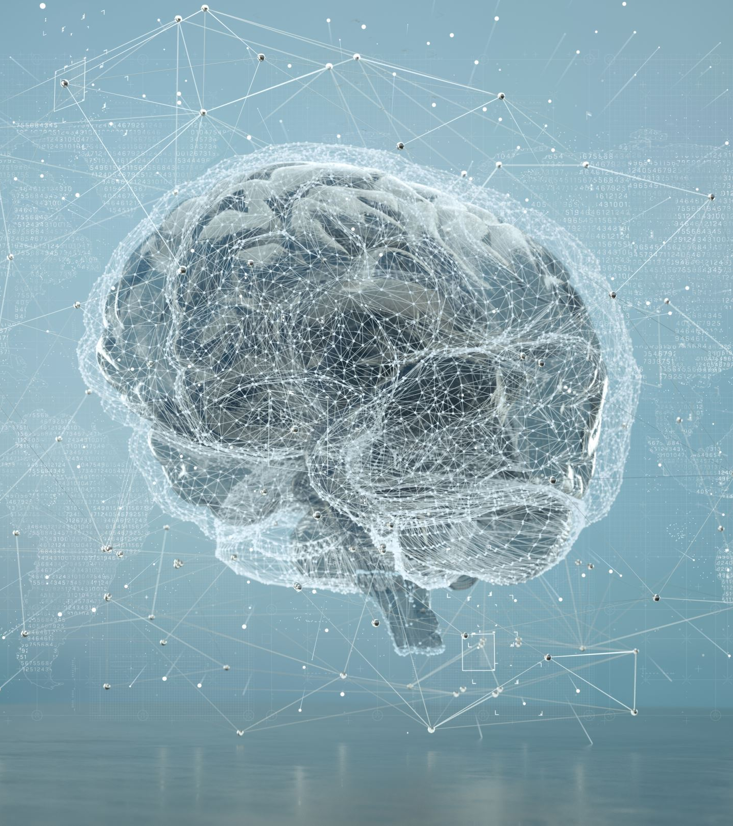

AUTOMATED BRAIN TUMOR DETECTION UISNG AI
PRESENTED BY:
JESHWANTH DHARNA
SREE VIDYA JAGATAP

Slide 2
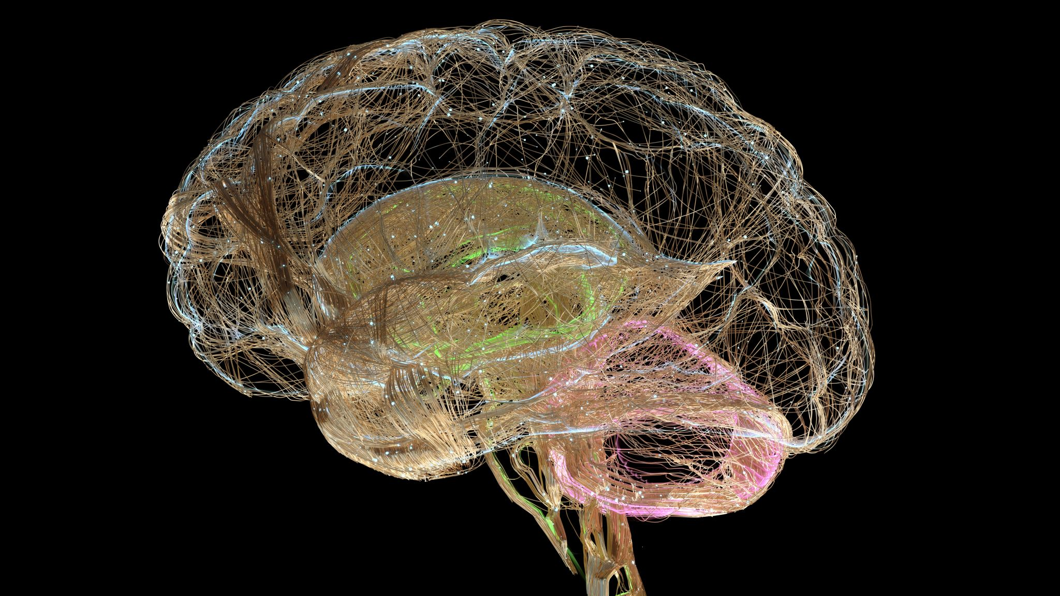
ABSTRACT
This project explores the potential of Convolutional Neural Networks (CNN) and Long Short-Term Memory (LSTM) networks for the classification of brain tumors.
By leveraging pre-trained models on extensive datasets, this approach aims to enhance the accuracy and efficiency of brain tumor classification.
The integration of CNNs allows for effective feature extraction from complex medical images, such as MRIs, while LSTMs contribute to analyzing sequential data, potentially improving the interpretation of tumor progression over time.
This synergy aims to offer a robust tool for medical diagnosis, aiding in the timely and precise identification of various brain tumor types.

Slide 3

OBJECTIVE
The primary objective is to develop an AI-based model that accurately classifies different types of brain tumors from MRI scans, utilizing the strengths of CNNs for spatial feature extraction and LSTMs for analyzing sequential patterns. Ultimately, the goal is to contribute a valuable tool to the medical field for enhancing the speed and precision of brain tumor diagnosis.

Slide 4
INTRODUCTION
This project aims to develop an AI-based system for brain tumor classification using Convolutional Neural Networks (CNN) and Long Short-Term Memory (LSTM) networks. Focusing on the precise and efficient analysis of MRI images, the system is designed to automate and improve the accuracy of tumor detection and classification. By integrating advanced deep learning techniques, it seeks to overcome the limitations of current diagnostic methods, offering a promising tool in medical imaging and contributing to improved patient care in neuro-oncology.

Slide 5
APPROCH
The system integrates a combination of Convolutional Neural Networks (CNN) and Long Short-Term Memory (LSTM) networks through transfer learning for brain tumor classification. This system is designed to:
Automate Feature Extraction: Using CNNs to automatically extract features from MRI images, reducing the reliance on manual analysis.
Analyze Sequential Data: Incorporating LSTMs to potentially analyze changes in tumor characteristics over time or across a sequence of images.

Slide 6
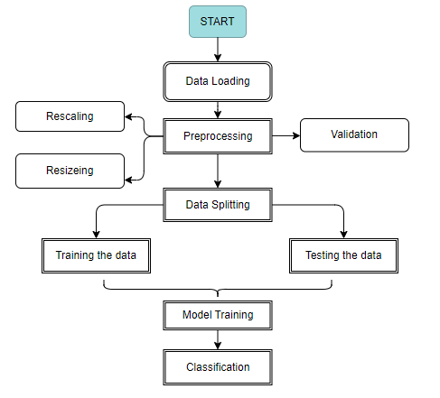
PROJECT FLOW

Slide 7
EVALUATION METHODOLOGY
Here's a detailed methodology of how these algorithms work in the context of brain tumor classification:
Convolution Neural Network (CNN):
CNNs are adept at extracting features from images. In this project, the CNN layers automatically identify patterns and features in MRI images that are indicative of brain tumors, such as textures, edges, and shapes.
The CNN architecture typically consists of convolutional layers, pooling layers, and fully connected layers. Each convolutional layer applies various filters to the input, creating feature maps. Pooling layers reduce the dimensionality of these feature maps, helping in reducing computational complexity and overfitting.

Slide 8
Long Short-Term Memory Networks (LSTM)
LSTMs are a type of recurrent neural network (RNN) capable of learning order dependence in sequence prediction problems. In this project, they can be used to analyze sequential MRI images of a patient, capturing the progression or regression of brain tumors over time.
LSTM units include a cell, an input gate, an output gate, and a forget gate. These components allow them to regulate the flow of information, remember important information, and forget non-essential details, making them effective for sequential analysis.
The output of the CNN (feature-extracted images) can be fed into the LSTM. This integration allows the model to not only recognize features indicative of tumors but also understand their progression across a series of images.

Slide 9
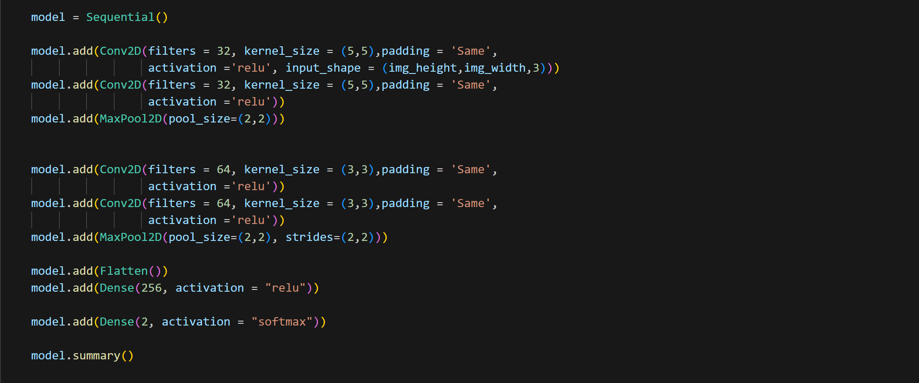
Here is the following model that was created via CNN with fully connected layers

Slide 10
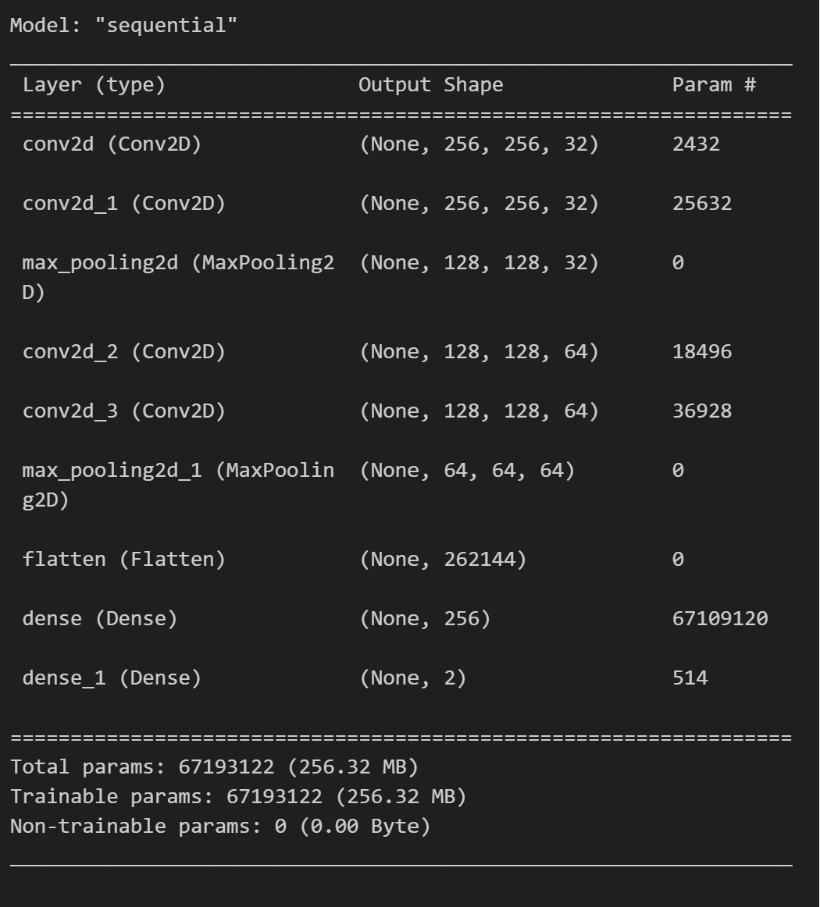
And here is the result that specifies the total parameters of the CNN model

Slide 11
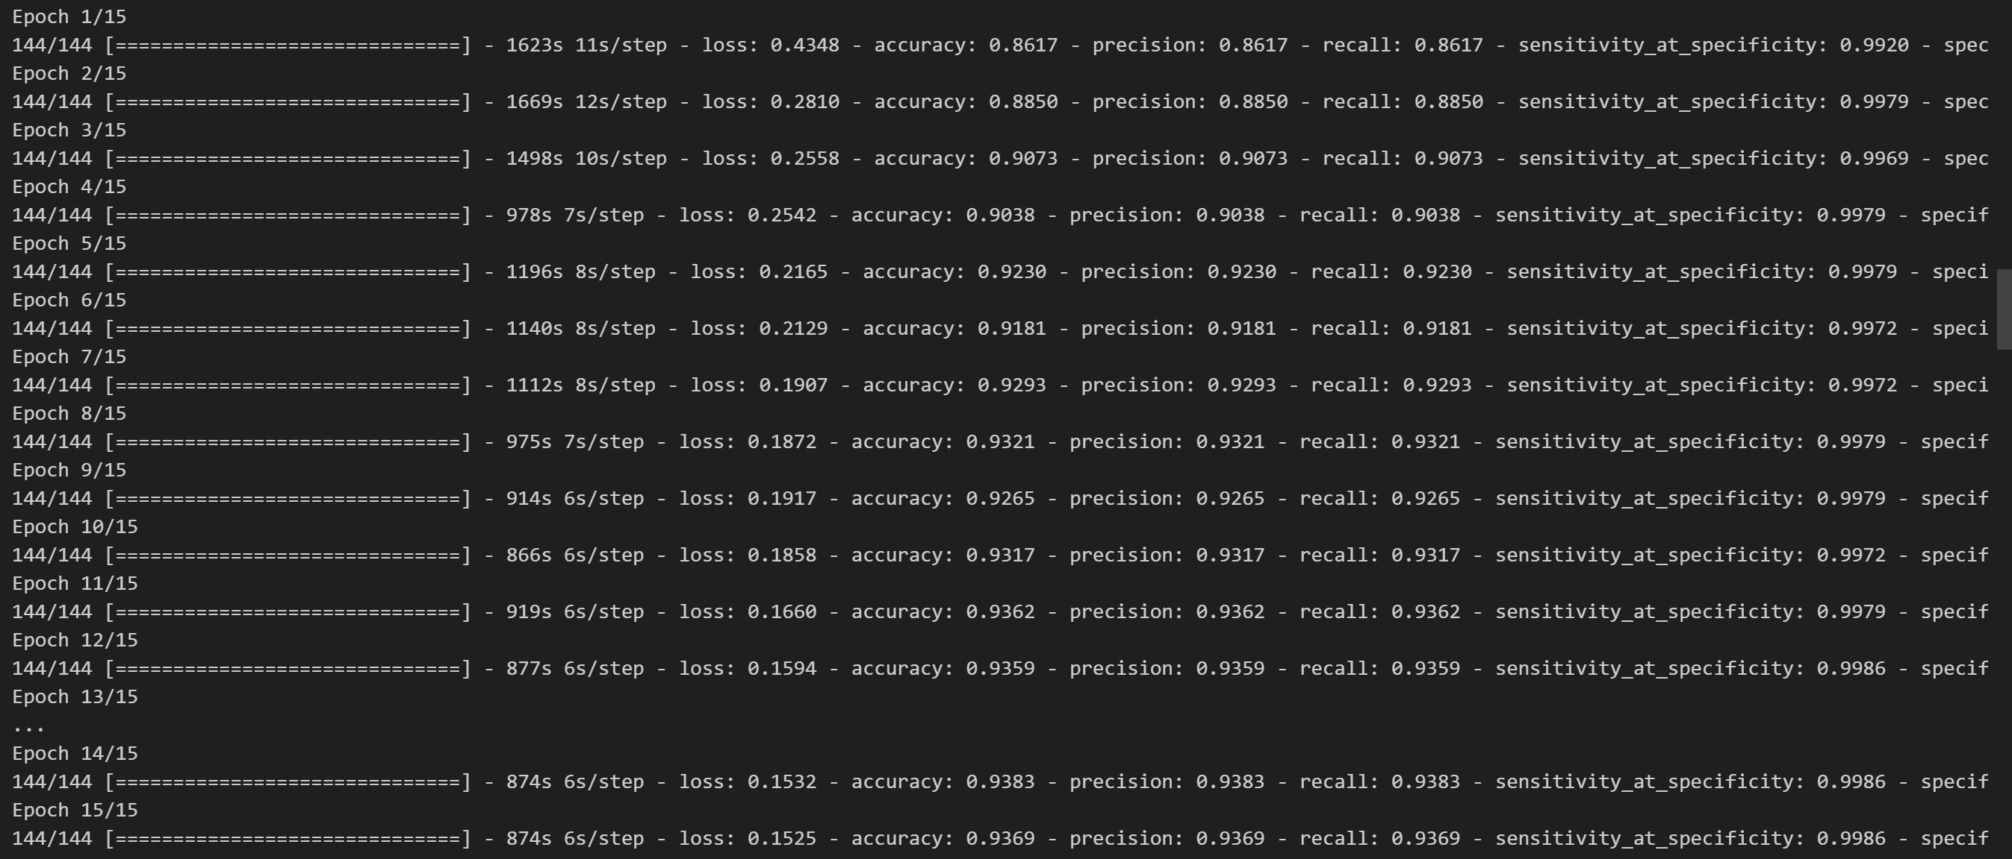
We start training CNN model for epochs

Slide 12
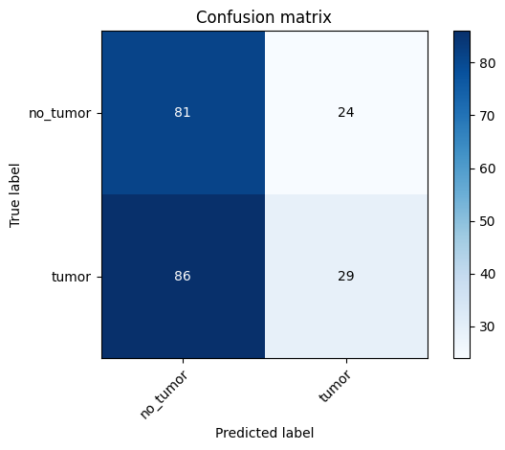
Confusion Matrix for CNN

Slide 13
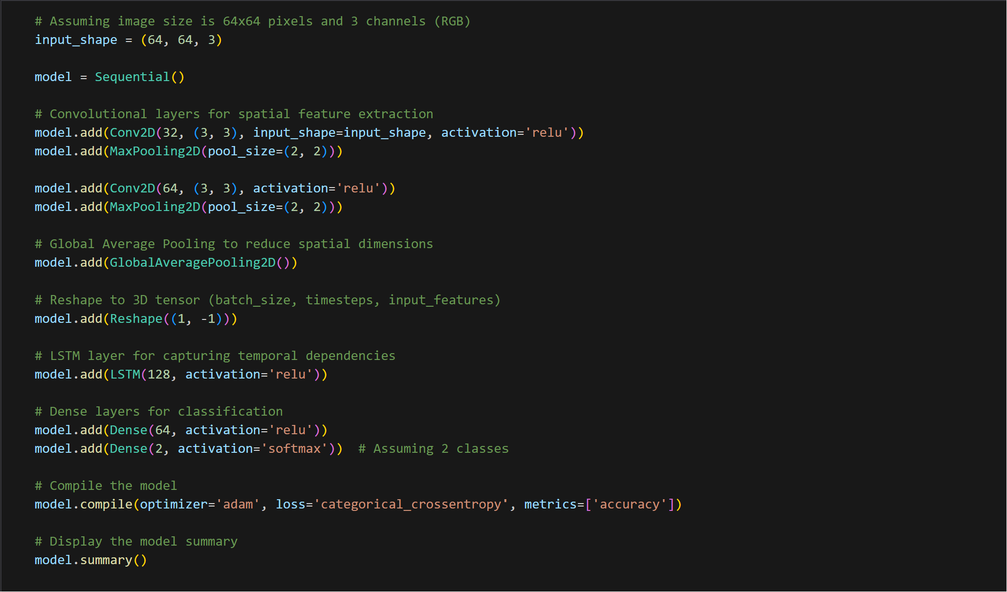
Here is the following model that was created via LSTM with fully connected layers

Slide 14
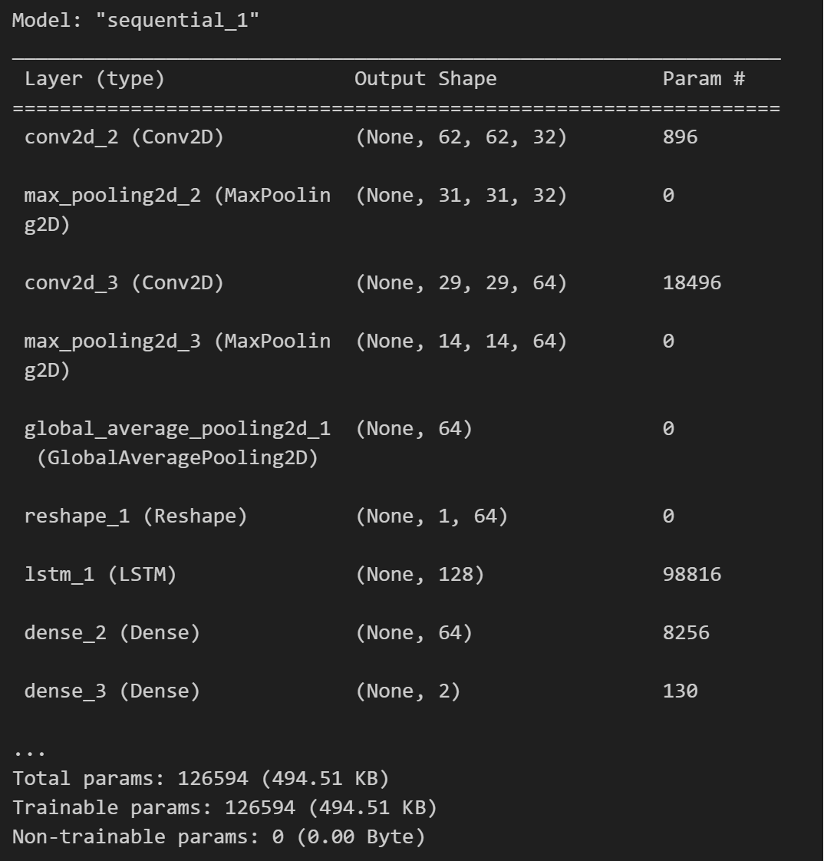
And here is the result that specifies the total parameters of the LSTM model

Slide 15
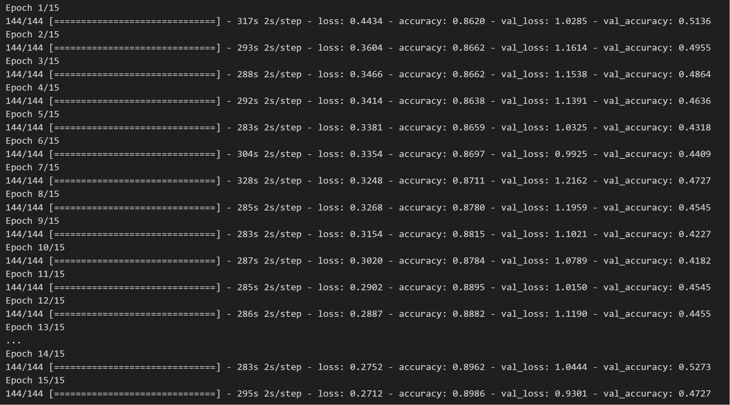
We start training LSTM model for epochs

Slide 16
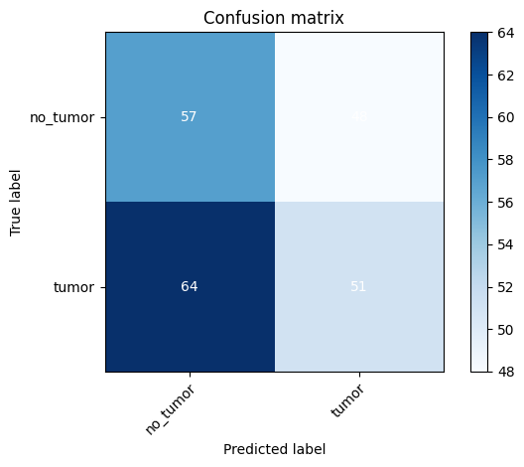
Confusion Matrix for LSTM

Slide 17
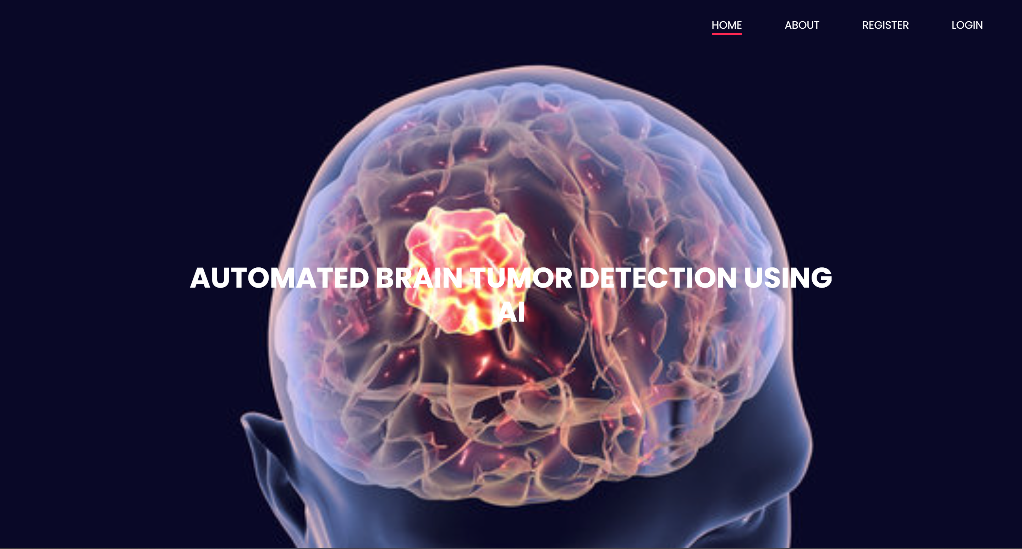
RESULT
Home Page

Slide 18
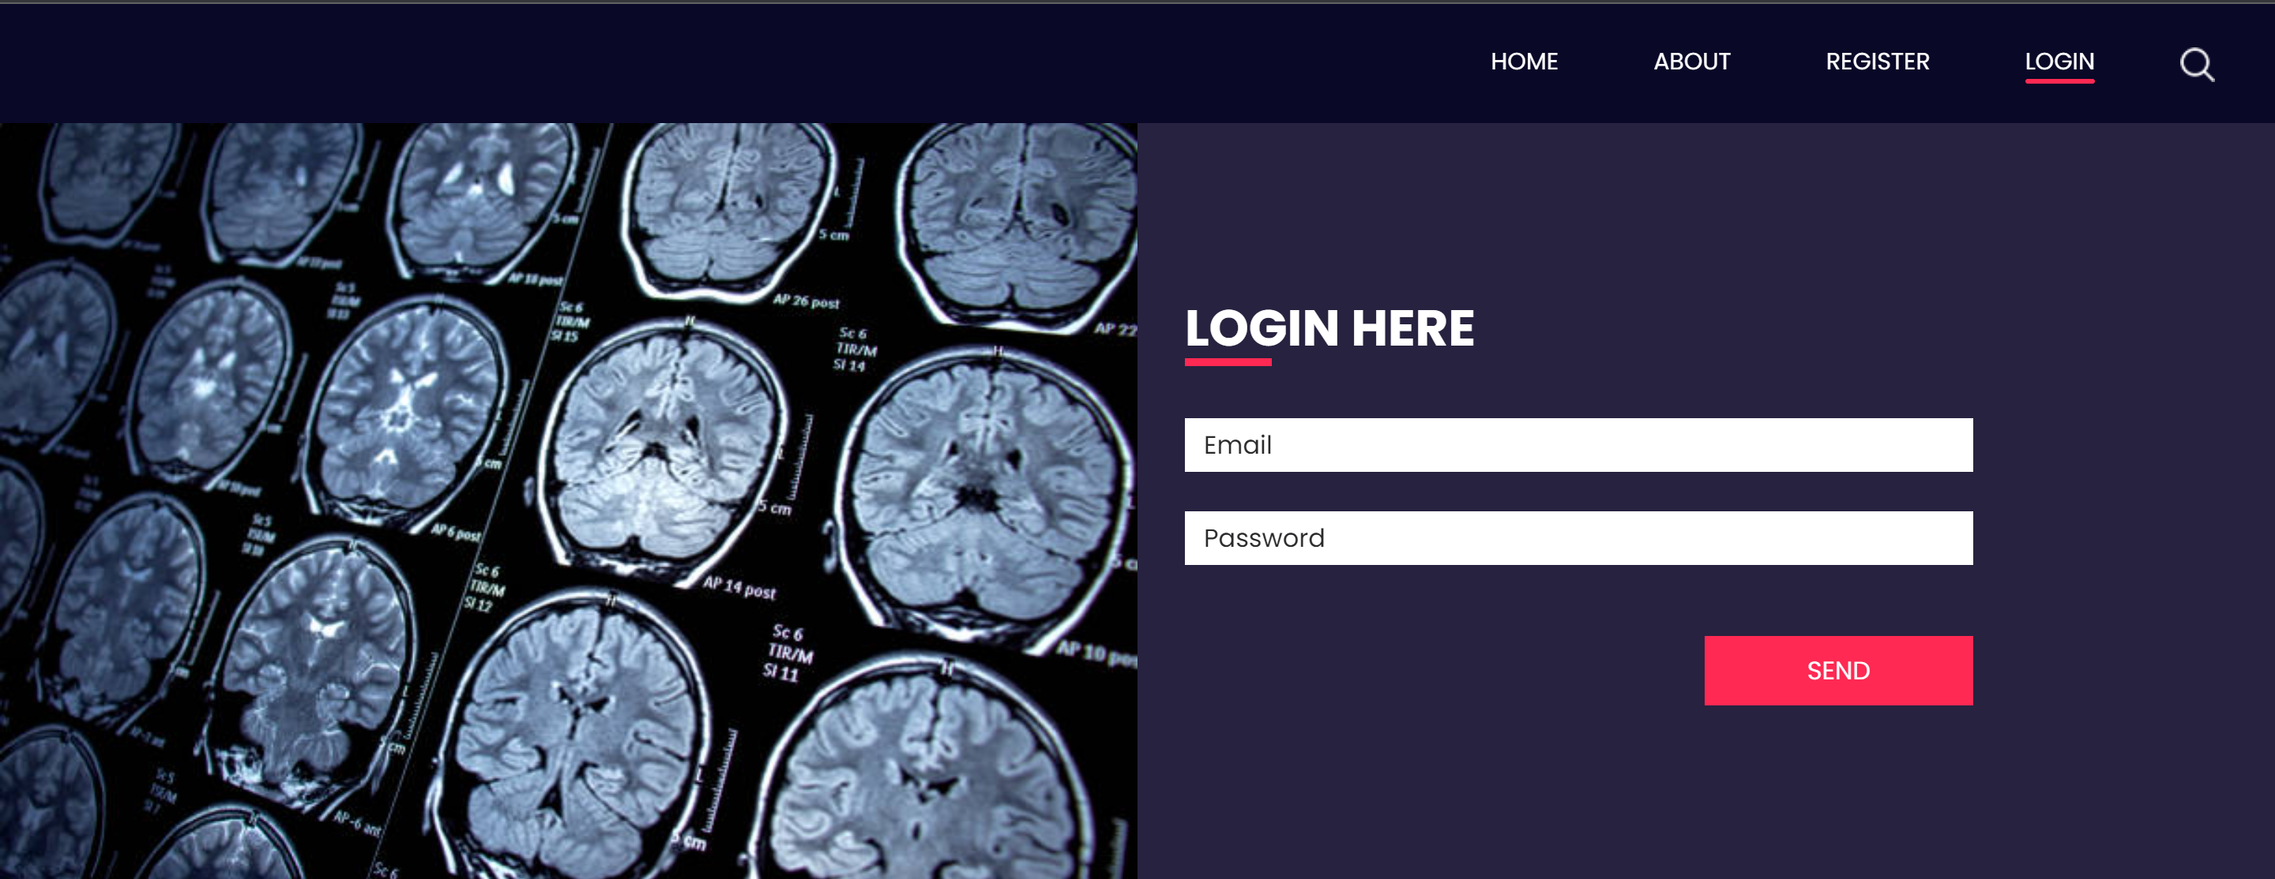
RESULT
Login Page

Slide 19


RESULT
Upload Page
CNN
LSTM

Slide 20
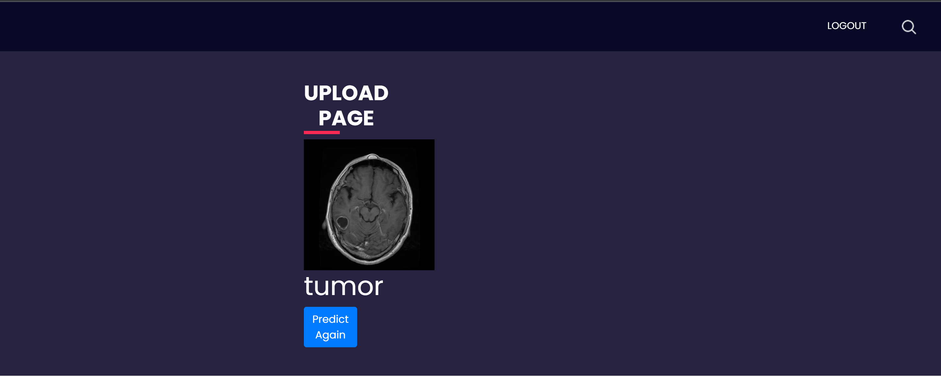

RESULT
Upload Page
CNN
LSTM

Slide 21
CONCLUSION
The project successfully demonstrates the potential of combining Convolutional Neural Networks (CNN) and Long Short-Term Memory (LSTM) networks for efficient and accurate brain tumor classification.
We have compared CNN with LSTM. The result of the comparison CNN is more accurate than LSTM.
The high-performance metrics, improved speed over traditional methods, highlight the model's effectiveness and usability.
While challenges such as data diversity and model interpretability remain, the project sets a foundation for future advancements in AI-driven medical imaging.
It underscores the transformative impact AI can have in enhancing diagnostic processes and patient care in neuro-oncology.

Slide 22
FUTURE ENHANCEMENT
Future work for this project includes expanding the dataset to include a broader range of tumor types and stages, enhancing the model's generalizability and accuracy. Integrating advanced AI techniques such as Generative Adversarial Networks (GANs) could address data scarcity and variability. Efforts to improve the model's interpretability will be crucial for clinical acceptance and ethical compliance. Additionally, exploring real-time analysis capabilities and seamless integration with diverse healthcare systems will enhance practical usability.

Slide 23
REFERENCES
[1] J. Doe et al., "Advanced CNN Architectures for Brain Tumor Classification from MRI Images," in Journal of Medical Imaging and Health Informatics, vol. 10, no. 4, pp. 950-957, 2023.
[2] A. Smith and B. Johnson, "Utilizing Long Short-Term Memory Networks for Analyzing Temporal Progression in Brain Tumors," IEEE Transactions on Medical Imaging, vol. 42, no. 3, pp. 1234-1242, March 2023.
[3] O. Black, "Exploring the Synergy of CNN and LSTM Networks in Medical Image Analysis," IEEE Access, vol. 11, pp. 3344-3352, 2023.
[4] K. Davis, "The Impact of Deep Learning in Neuro-Oncology," IEEE Reviews in Biomedical Engineering, vol. 15, pp. 78-85, 2023.
[5] M. White and N. Green, "Comparative Analysis of Pre-Trained CNN Models for Brain Tumor MRI Classification," in Journal of AI in Medicine, vol. 7, no. 2, pp. 45-53, April 2023.

Slide 24
THANK YOU

